Slide 1

MGMT 582 Final Project
Group 7

Slide 2
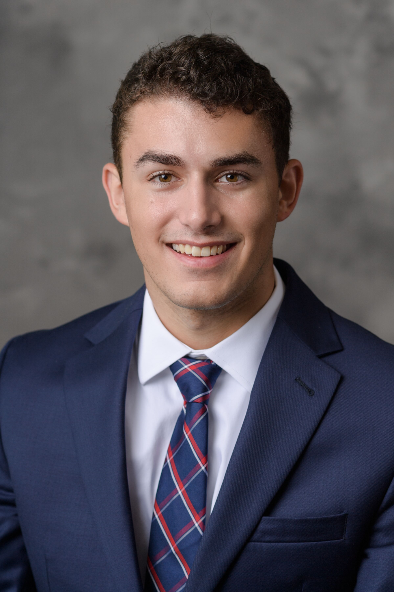





Meet the Team
Alex Scarcelli
Archita Ray
Ashvin Raj
Priyam Sarkar
Sai Mona Duvvapu
Vamsi Krishna Seemakurthi

Slide 3
Contents
About the Client
Objective
ERD
Relational Model
Normalization
Queries & Insights
Recommendation
Questions

Slide 4
About ASP OL Media
ASP OL Media is a leading marketing company serving some of the Fortune 100 companies, managing daily email campaigns for over 8 million emails. With a workforce of 170+ professionals, they ensure effective marketing strategies through meticulous assessments and quality control measures.

Slide 5
Objective
Create & organise database for the company, while checking for duplicates & anomalies in data.
Optimize the existing systems and come up with recommendations for successful ad campaigns.

Slide 6
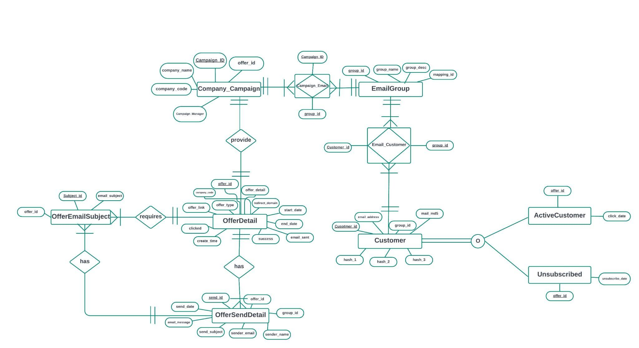
ERD

Slide 7
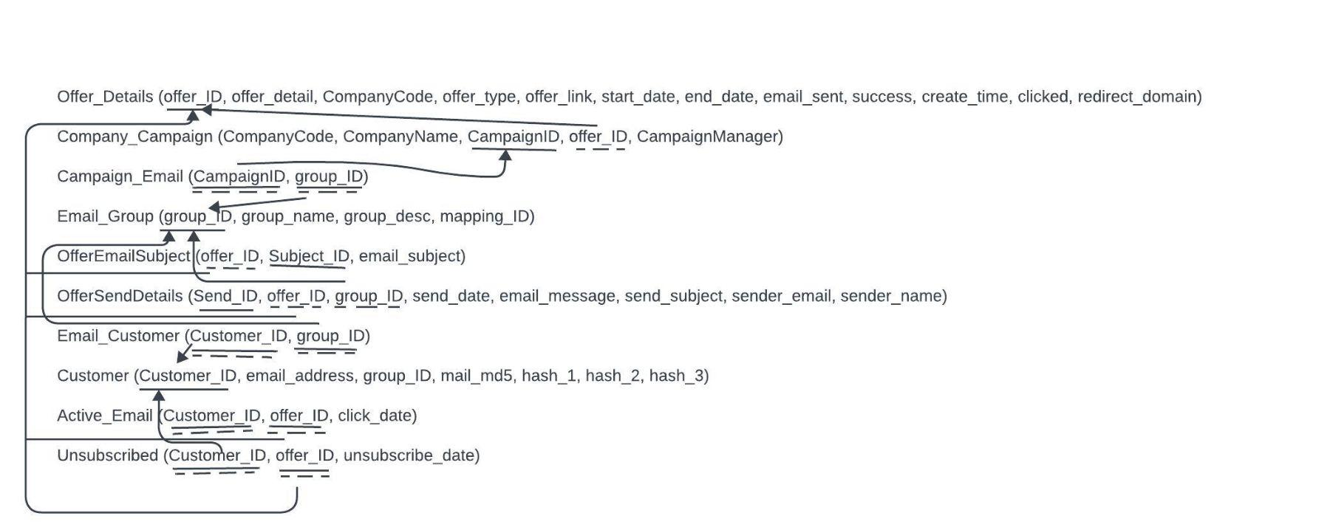
Relational Model

Slide 8
Normalization
Offer_ID -> offer_detail, Company_Code, offer_type, offer_link, start_date, end_date, email_sent, success, create_time, clicked, redirect_domain
Company_Code -> CompanyName, campaignManager
CampaignID -> offer_ID, CompanyCode
CampaignID, group_ID ->
Group_ID -> group_name, group_desc, mapping_ID
Subject_ID -> offer_ID, email_subject

Slide 9
Normalization
Send_ID -> offer_ID, group_ID, send_date, email_message, send_subject, sender_email, sender_name
Customer_ID, group_ID ->
Customer_ID -> email_address, group_ID, mail_md5, hash_1, hash_2, hash_3)
Customer_ID, offer_ID -> click_date
Customer_ID, offer_ID -> unsubscribe_date

Slide 10
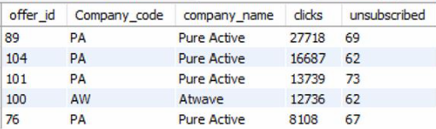
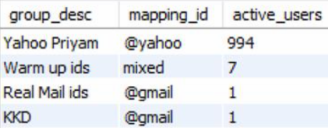
Queries & Insights
select a.offer_id,a.Company_code,b.company_name,max(clicked) as clicks,count(unsubscribe_date) as unsubscribed
from offer_details a left join company b on a.Company_code=b.Company_code
left join unsubscribed c on a.offer_id=c.offer_id
group by 1, 2, 3 order by 4 desc, 5 asc;
Pure Active has the most successful Ad Campaigns (low subscriptions & most clicks)
Select group_desc, mapping_id, Count(active_emails.Customer_id)
from email_group inner join customer on email_group.group_id = customer.group_id
inner join active_emails on customer.Customer_id = active_emails.Customer_id
Group by mapping_id, group_desc Order By Count(active_emails.Customer_id) DESC;
Yahoo domain has the most active users

Slide 11
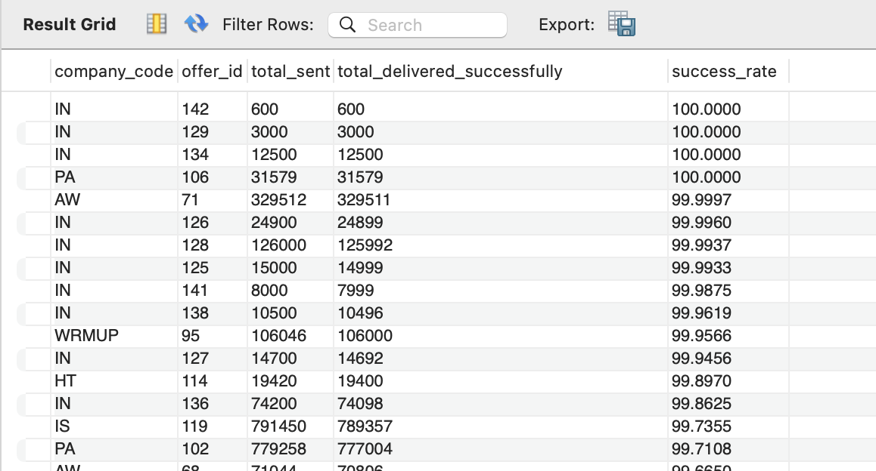
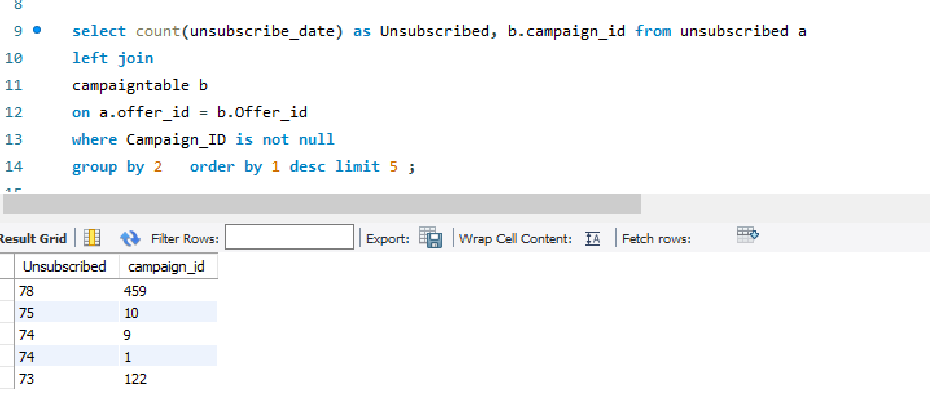
Queries & Insights
Select company_code, offer_id, sum(email_sent) as total_sent, sum(success) as total_delivered_successfully,
(sum(success)/sum(email_sent))*100 as success_rate from offer_details group by offer_id order by 5 DESC;
Companies Instar & Pure Active for 2 offers have 100% delivery success rate.
select count(unsubscribe_date) as Unsubscribed, b.campaign_id from unsubscribed a
left join campaigntable b on a.offer_id = b.Offer_id
where Campaign_ID is not null group by 2 order by 1 desc limit 5 ;
Campaign_ID 459 has most unsubscribed users

Slide 12
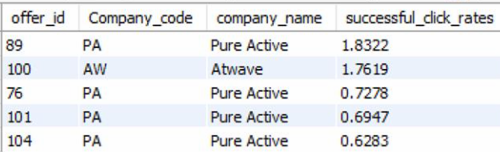
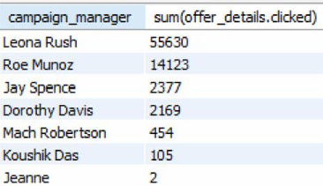
Queries & Insights
SELECT a.offer_id, a.Company_code, b.company_name, (a.clicked / a.success) * 100 AS successful_click_rates
FROM offer_details AS a LEFT JOIN company AS b ON a.Company_code = b.Company_code
GROUP BY b.company_name, a.offer_id
ORDER BY successful_click_rates DESC limit 5;
Pure Active has most successful email campaigns, offer_id 89 being the best
select company.campaign_manager, sum(offer_details.clicked) as clicked
from campaigntable join offer_details on campaigntable.Offer_ID = offer_details.offer_id
join company on company.company_code = campaigntable.company_code group by Campaign_Manager order by sum(offer_details.clicked) desc;
Leona Rush from Pure Active is the best Campaign Manager

Slide 13
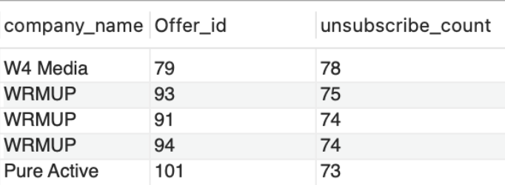
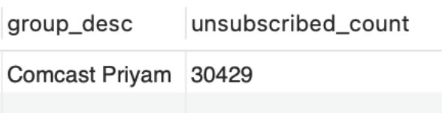
Queries & Insights
SSelect company.company_name, unsubscribed.Offer_id, count(unsubscribed.Offer_id) as unsubscribe_count
From unsubscribed Inner Join campaigntable On campaigntable.Offer_ID = unsubscribed.Offer_ID
Inner Join company On company.company_code = campaigntable.company_code
Group By Offer_id, company_name Order By count(Offer_id) DESC Limit 5;
W4 Media has the most unsubscribed users, with its Offer_id 79 having 78 users who have unsubscribed.
Select group_desc, Count(unsubscribed.id) as unsubscribed_count from email_group
inner join offersenddetails on offersenddetails.group_id = email_group.group_id
inner join unsubscribed on unsubscribed.offer_id = offersenddetails.offer_id
Group By group_desc Order By Count(id) Limit 1;
Comcast Priyam is the group with major unsubscriptions

Slide 14
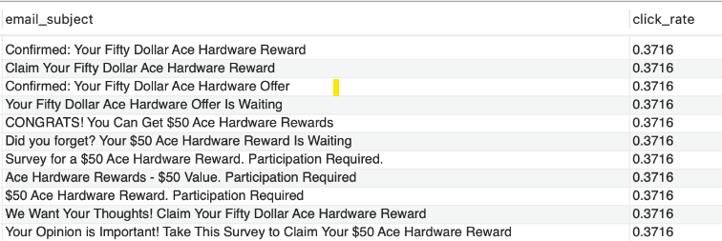
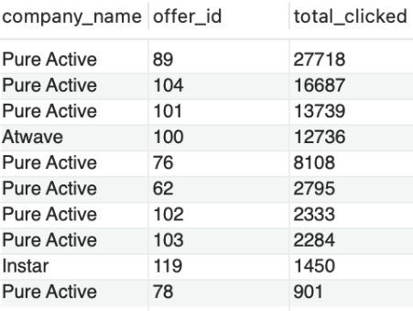
Queries & Insights
Select email_subject, (sum(offer_details.clicked)/sum(offer_details.success))*100 as click_rate
From offer_email_subject Inner Join offer_details on offer_details.offer_id = offer_email_subject.offer_id
Group By email_subject Order By click_rate DESC;
Select company.company_name, offer_id, sum(clicked) as total_clicked
from offer_details Inner Join company on company.company_code = offer_details.company_code
Group By offer_id , company_name Order By sum(clicked) DESC Limit 10;
Pure Active running the most successful ads with the highest number of clicks

Slide 15
Recommendations
Further investigation behind the reason why a specific "Campaign_ID" experiences a higher count of users who have unsubscribed is required.
ASPOL media should focus on capturing data points like open rate and cumulative clicks to get some visibility into customer behaviour thereby improving response to campaign ads.
Campaigns should be targeted based on the email group performance to boost clicked email %.
We recommend that click rate be captured on email subject level instead of campaignID to improve visibility into success of a campaign.

Slide 16
Questions

Slide 17
Thank you!

